Slide 1
CH₄ content: 52-61%
CH₄ content: 67-79%
CH₄ content: 85-95%
H₂
Conventional AD
Optimum AD
In-situ methane enriched AD
Graphical abstract figure

Slide 2
Figure 1
Biogas upgrading methods
Ex situ (CO₂ & impurities removal from biogas)
In situ (modification of liquid-gas interaction)
Absorption technology
Chemical absorption
Physical absorption
Pressure swing absorption
Water scrubbing
Absorption technology
Pressurized reactor
Digestate recirculation
Membrane technology
Hydrogenotrophic methanogenesis
Direct H₂ addition
Electromethanogenesis
Cryogenic separation
Biological technique
Figure 1: Different modes of biogas upgrading techniques

Slide 3
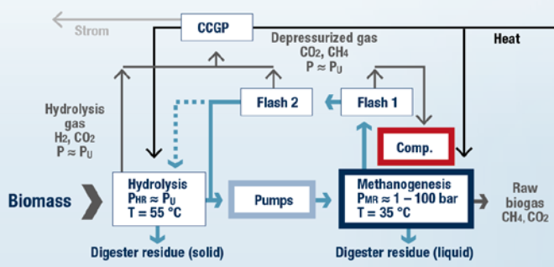
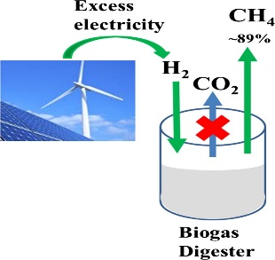
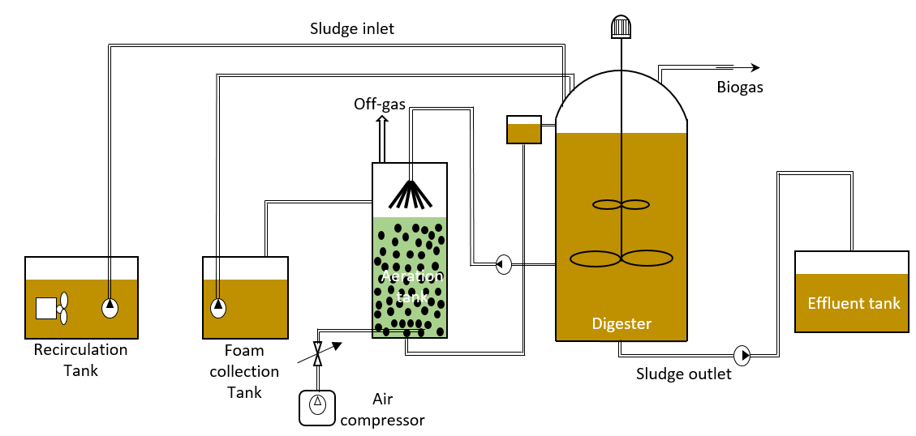
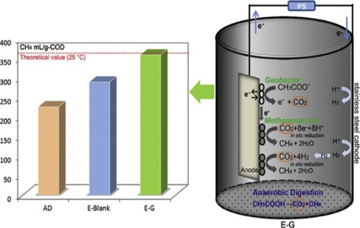
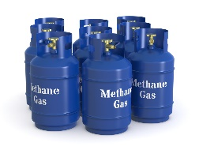
Figure 2
85 to 95% CH₄
In situ biogas upgrading
Pressurized reactor
H₂-enriched reactor
Minimum purification
Pipeline quality methane
CO₂ absorption/digestate recirculation
Bioelectromethanogenesis
Figure 2: Biogas enrichment using in situ techniques

Slide 4
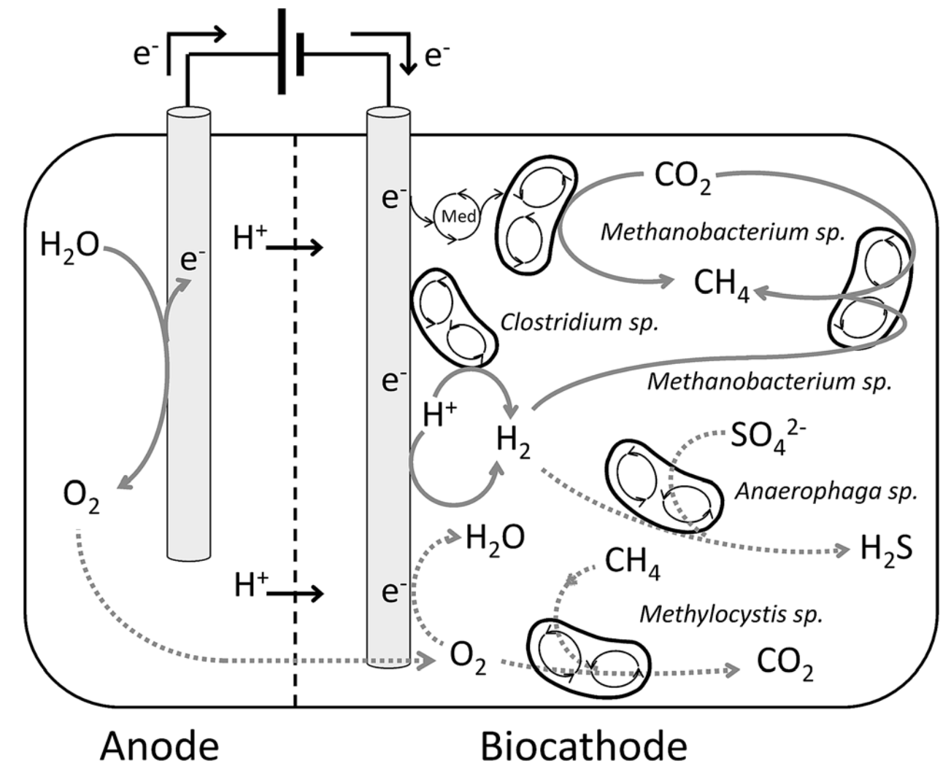
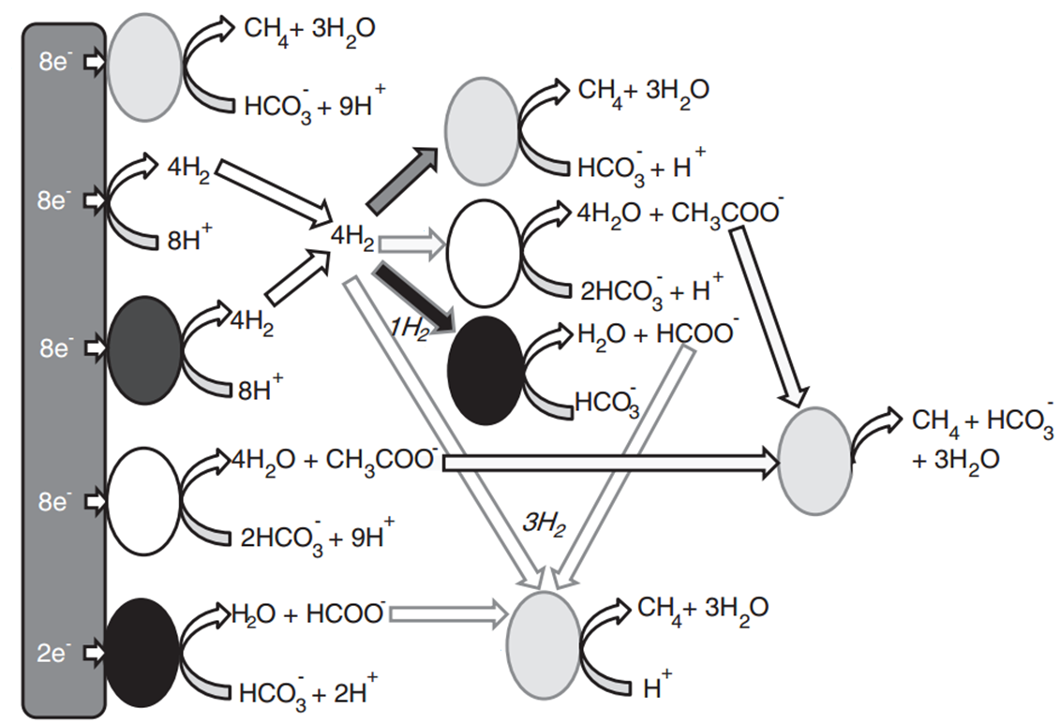
Figure 3
Anode
Biocathode
Biocathode
Figure 3: Interaction of some methane producing microorganisms and possible mechanisms to produce bioelectrochemical methane (adapted from Refs. [68, 72])

